Slide 1
Advanced To-Do List Application
Internship Project by
N.Chethan Reddy

Slide 2
Abstract
The To-Do List Application is a task management tool developed using Python and CustomTkinter. It allows users to add, edit, delete, and categorize tasks with priority levels. Users can mark tasks as complete, switch between themes, and save/load tasks from a file. The application enhances productivity by offering a clean, interactive, and modern user interface.

Slide 3
Introduction
Managing tasks effectively is crucial for productivity. This app enables users to:
- Add new tasks with priority
- Edit or delete tasks
- Mark tasks as complete
- Save/load tasks to maintain persistence
- Use dark/light mode for comfort
- View task timestamps
Built with Python’s CustomTkinter library for a modern look.

Slide 4
Features
- Add Tasks
- Mark as Complete
- Edit and Delete Tasks
- Priority Levels: Low, Medium, High
- Timestamp for each task
- Save/Load functionality
- Light/Dark Mode toggle
- Scrollable Task List

Slide 5
Technologies Used
- Language: Python
- GUI: CustomTkinter (Tkinter modern UI)
- File I/O: tasks saved in .txt format
- Libraries: datetime, tkinter.messagebox

Slide 6
Simulated Output Interface
[High] Finish Python Project (2025-06-11 14:32)
[Medium] Call mentor (2025-06-11 13:20)
[Low] Buy groceries (2025-06-11 10:45)
[✔] Completed: Submit internship report

Slide 7
Conclusion
This advanced To-Do List app demonstrates how modern UI and Python programming can create a productive tool. Its robust features and attractive interface make it ideal for daily planning and task management. The project can be expanded further by integrating notifications, deadlines, or cloud sync.

Slide 8

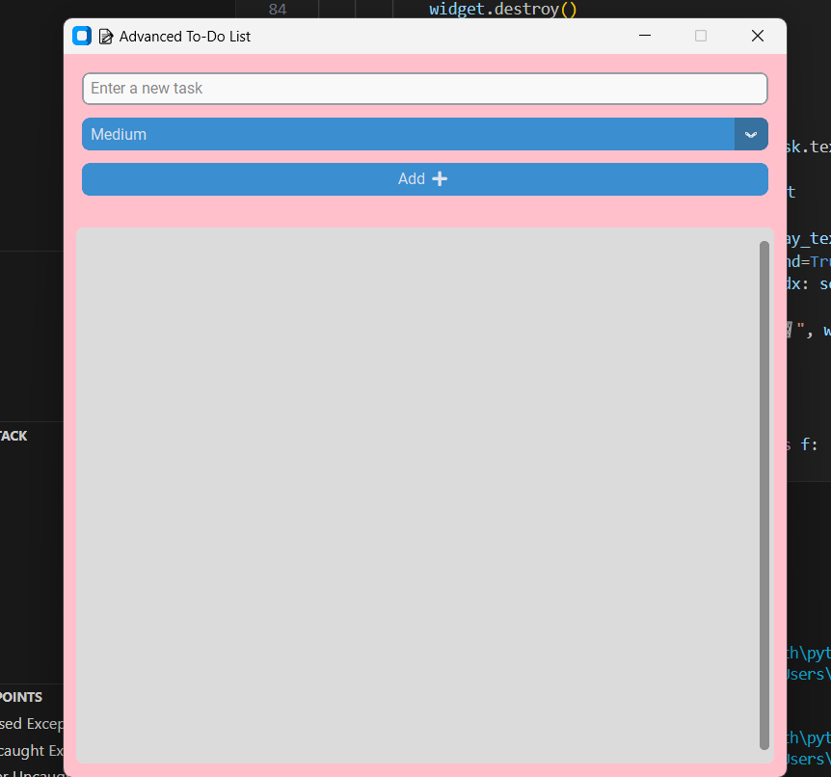
CONCLUSION(WORKING OF TO-DO LIST)

